Slide 1
PYTHON -2
PRITU A PATEL

Slide 2
T2 - PHASE CONTENT
Introduction to Machine Learning & Types of Machine Learning
Classification vs Regression
Data cleaning & EDA , Train-validation split
Regression - Model Training and Evaluation
Simple and Multilinear Regression
Polynomial Regression
Classification - Model Training and Evaluation
KNN(K-Nearest Neighbors) Algorithm
Decision Tree Algorithm using Entropy
Random Forest Algorithm
SVM (Support Vector Machine) Algorithm
Introduction to Deep Learning

Slide 3
What is Machine Learning?
Machine Learning = Learning from data to make predictions or decisions.
Machine learning is a branch of artificial intelligence that enables algorithms to uncover hidden patterns within datasets.
It allows them to predict new, similar data without explicit programming for each task.
Machine learning finds applications in diverse fields such as image and speech recognition, natural language processing, recommendation systems, fraud detection, and automating tasks.

Slide 4
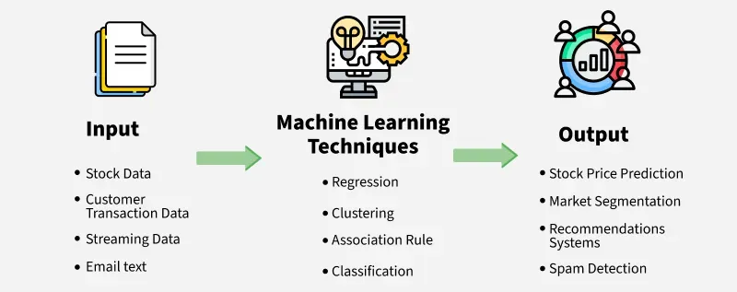
What is Machine Learning?

Slide 5
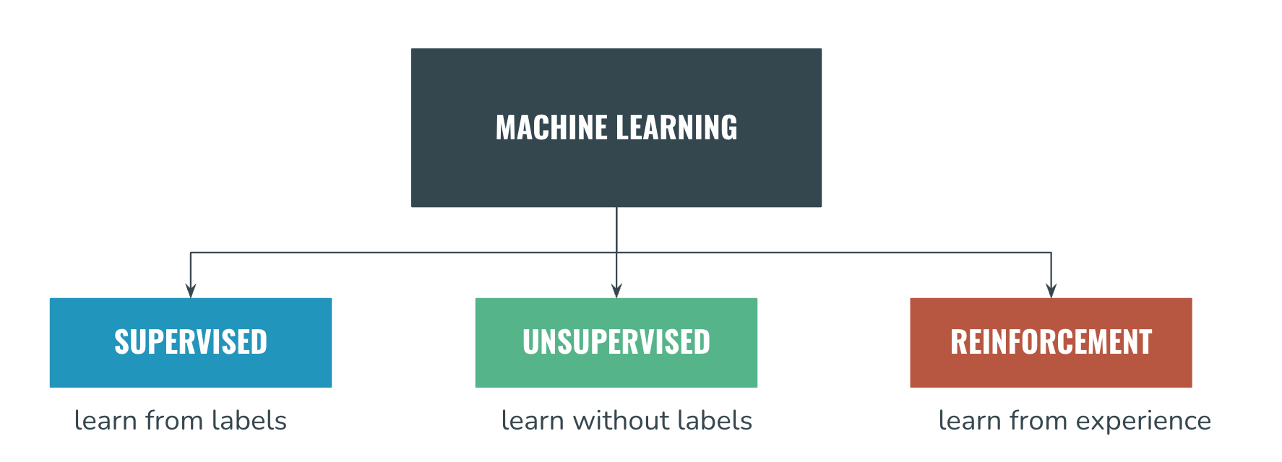
Types of Machine Learning

Slide 6
Supervised Learning
Involves training models using labeled datasets. Both input and output variables are provided during training.
The aim is to establish a mapping function that predicts outcomes for new, unseen data.
Common applications include classification, regression, and forecasting.

Slide 7
Unsupervised Learning
Works with unlabeled data where outputs are not known in advance.
The model identifies hidden structures, relationships, or groupings in the data.
Useful for clustering, dimensionality reduction, and anomaly detection.
Focuses on discovering inherent patterns within datasets.

Slide 8
Reinforcement Learning
Model Learn from their mistakes.
Based on decision-making through interaction with an environment.
An agent performs actions and receives rewards or penalties as feedback.
The goal is to learn an optimal strategy that maximizes long-term rewards.
Widely applied in robotics, autonomous systems, and strategic game playing.

Slide 9
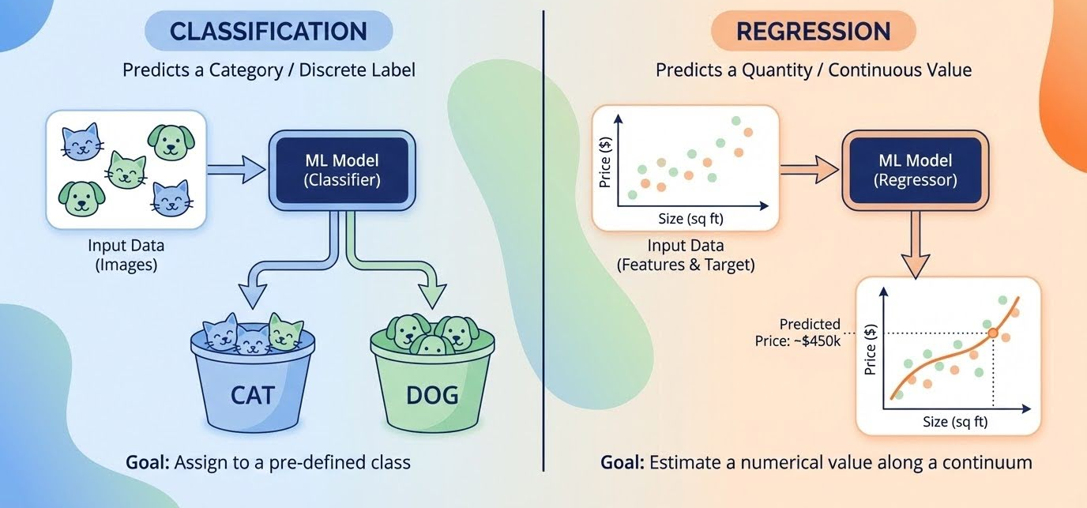
Classification vs Regression

Slide 10
Classification
Goal: Map input data to specific categories or classes.
Target: Categorical/Discrete (0/1, Yes/No, Red/Blue/Green).
Algorithms: Logistic Regression, Decision Trees, Random Forests, Support Vector Machines (SVM)
Applications: Email spam detection, image classification, sentiment analysis.
Metrics: Accuracy, Precision, Recall, F1-Score.

Slide 11
Regression
Goal: Map input data to a continuous, numeric output by finding the best-fit line or curve.
Target: continuous(15.5, $2000)
Algorithms: Linear Regression, Polynomial Regression.
Applications: Predicting stock prices, forecasting demand, calculating housing values.
Metrics: Mean Squared Error, Mean Absolute Error, R2 Score.

Slide 12
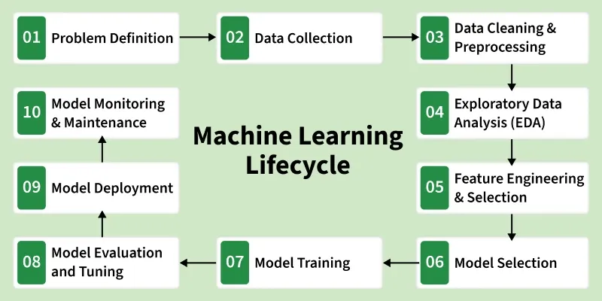
Machine Learning Model

Slide 13
Key Phase of ML Life Cycle
Problem Definition: Identify business goals, objectives, and success criteria to define what to solve.
Data Collection: Gather relevant data from various sources (databases, APIs, web scraping).
Data Preparation & Cleaning: Clean data to handle missing values, duplicates, and noise. This "data wrangling" makes raw data usable.
Data Exploration & Feature Engineering: Analyze data patterns through visualization and create new features that improve model performance.

Slide 14
Key Phase of ML Life Cycle
Model Development (Training & Tuning): Select algorithms, train the model, and tune hyperparameters to achieve the best performance.
Model Evaluation & Testing: Validate the model using testing data to ensure it meets success metrics before production.
Deployment & Monitoring: Deploy the model into a production environment and continuously monitor it for performance degradation (e.g., data drift).

Slide 15
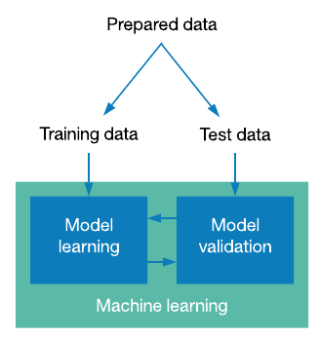
Train Data & Test Data
Train Data Size : 70-80 %
Test Data Size : 20-30 %

Slide 16
Feature Selection
Feature selection is the process of choosing only the most useful input features for a machine learning model. It helps improve model performance, reduces noise and makes results easier to understand.
Helps remove irrelevant and redundant features
Improves accuracy and reduces overfitting
Speeds up model training
Makes models simpler and easier to interpret

Slide 17
Model Selection (Data Splitting)
Step :1 import Library
from sklearn.model_selection import train_test_split
Step :2 Load the dataset
df = pd.read_csv(“filename.csv”)
Step :3 Data cleaning & EDA (if needed)
Step :4 Feature Selection (Select the particular columns for train - test data)
Getting x and y
Step :5 Data Splitting
x_train,x_test,y_train,y_test = train_test_split(x,y,test_size=0.2,random_state=10)

Slide 18
Model Selection (Components)
x and y: These are your original datasets. x typically represents the features (independent variables), while y represents the target (dependent variable).
test_size=0.2: This parameter determines the proportion of the dataset allocated to the test set. Here, 20% of the data is reserved for testing, while the remaining 80% is used for training the model.
random_state=10: This acts as a seed for the pseudo-random number generator. Setting it to a specific integer (like 10) ensures reproducibility; you will get the exact same split every time you run the code, which is essential for debugging and comparing different models.

Slide 19
Model Selection ( Components)
Return Values: The function returns four separate arrays in a specific order:
x_train: Feature data used to fit and train the model.
x_test: Feature data used to evaluate the model's performance.
y_train: Target values corresponding to x_train.
y_test: True target values used to compare against the model's predictions.

Slide 20
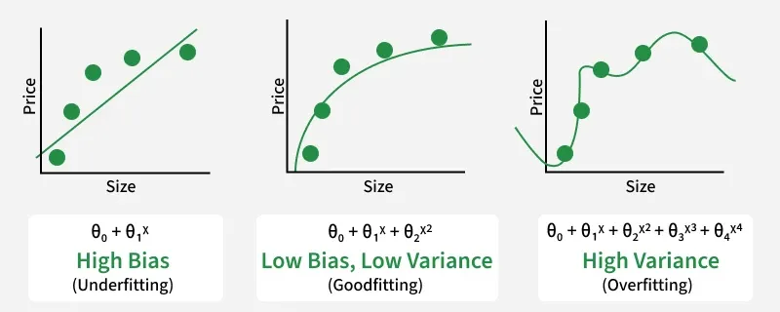
Overfitting vs Underfitting

Slide 21
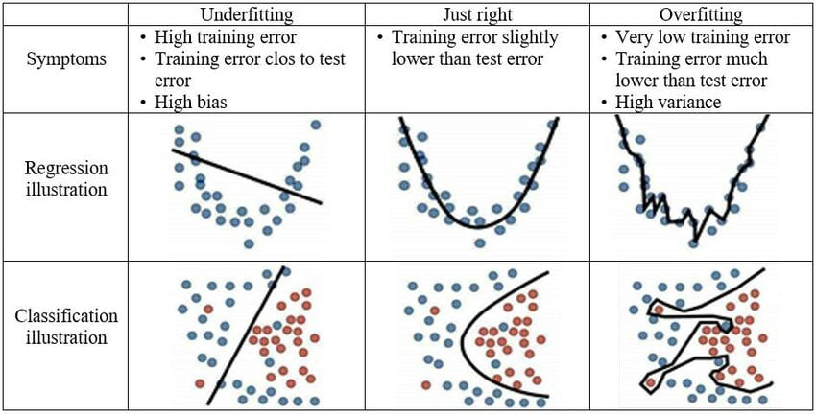
Overfitting vs Underfitting

